Slide 1
SQL Intro
Diplomatura Ciencia de Datos - UADE

Slide 2
Qué es una base de datos?
Una base de datos es una colección organizada de datos.
Existen diferentes tipo de base de datos de acuerdo al caso de uso.
Las base de datos digitales se han convertido en un componente importante de nuestro entorno desde su concepción en la década de los ‘60.
Notes:
A database is nothing but a collection of organized data. It doesn’t have to be in a digital format to be called a database. A telephone directory is a good example, which stores data about people and organizations with a contact number. A to-do list is also a rudimentary form of a database. With ever-larger amounts of data being collected about even the most mundane of processes, digital databases have become increasingly important since their inception in the 1960s.
Software that is used to manage a digital database is called a Database Management System (DBMS) . When you hear someone talking about PostgreSQL or MySQL, they are referring to a DBMS. A database is what is created when you use the DBMS software to store data about topics that make sense to you or your organization. For example, your company may use PostgreSQL to store inventory information about cellular phones – the product that you sell. In this case, you have created an inventory database using PostgreSQL as your DBMS.

Slide 3

DATABASE MANAGEMENT SYSTEM (DBMS)
Notes:
Un sistema gestor de base de datos (SGBD) es un conjunto de programas que permiten el almacenamiento, modificación y extracción de la información en una base de datos. Los usuarios pueden acceder a la información usando herramientas específicas de consulta y de generación de informes, o bien mediante aplicaciones al efecto.
Estos sistemas también proporcionan métodos para mantener la integridad de los datos, para administrar el acceso de usuarios a los datos y para recuperar la información si el sistema se corrompe. Permiten presentar la información de la base de datos en variados formatos. La mayoría incluyen un generador de informes. También pueden incluir un módulo gráfico que permita presentar la información con gráficos y tablas.
Generalmente se accede a los datos mediante lenguajes de consulta, lenguajes de alto nivel que simplifican la tarea de construir las aplicaciones. También simplifican las consultas y la presentación de la información. Un SGBD permite controlar el acceso a los datos, asegurar su integridad, gestionar el acceso concurrente a ellos, recuperar los datos tras un fallo del sistema y hacer copias de seguridad. Las bases de datos y los sistemas para su gestión son esenciales para cualquier área de negocio, y deben ser gestionados con esmero.
Atomicity
Atomicity means that you guarantee that either all of the transaction succeeds or none of it does. You don’t get part of it succeeding and part of it not. If one part of the transaction fails, the whole transaction fails. With atomicity, it’s either “all or nothing”.
Consistency
This ensures that you guarantee that all data will be consistent. All data will be valid according to all defined rules, including any constraints, cascades, and triggers that have been applied on the database.
Isolation
Guarantees that all transactions will occur in isolation. No transaction will be affected by any other transaction. So a transaction cannot read data from any other transaction that has not yet completed.
Durability
Durability means that, once a transaction is committed, it will remain in the system – even if there’s a system crash immediately following the transaction. Any changes from the transaction must be stored permanently. If the system tells the user that the transaction has succeeded, the transaction must have, in fact, succeeded.

Slide 4
Base de datos relacionales

Slide 5
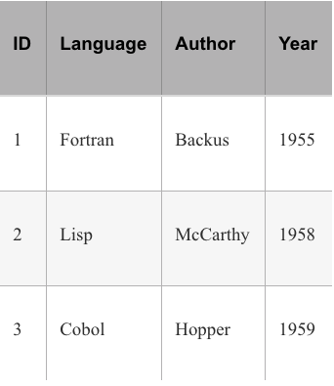
El modelo relacional y SQL
Los datos se generan en diferentes formas y tamaños.
Los datos generados en una transacción bancaria es diferente de cómo se registra un árbol familiar.
El modelo de base de datos que prevalece a la fecha es el relacional.
En este modelo los datos son almacenados en forma tabular en filas y columnas.
Notes:
Data comes in myriad shapes and sizes, and every context generates data in a different way. The data generated by a bank keeping a record of account balances is different from keeping track of members of a family tree. But for a DBMS to provide uniform data management and reporting capabilities, we must adhere to a data organization structure or data model.
The most prevalent database organizational model is the Relational Model, developed by Dr. E. F. Codd in his groundbreaking research paper – A Relational Model of Data for Large Shared Data Banks in 1970.1 In this model, the data to be stored is organized in a tabular format with rows and columns. Each row inside a table represents a distinct record with the column headings specifying the corresponding type of data stored. This is not unlike a spreadsheet where the first row can be thought of as column headings and the subsequent rows storing the actual data.

Slide 6

SQL (Structured Query Language)
SQL es el estándar para interactuar con base de datos relacionales.
A diferencia de otros lenguajes compilados o interpretados, SQL tiene cómo propósito gestionar base de datos relacionales.
SQL (alike) sigue siendo ampliamente utilizado incluso en implementaciones de NoSQL debido a su simplicidad.
Notes:
SQL stands for Structured Query Language, and it is the de facto standard for interacting with relational databases. Almost all database management systems you’ll come across will have an SQL implementation. SQL was standardized by the American National Standards Institute (ANSI) in 1986 and has undergone many revisions, most notably in 1992 and 1999. However, all DBMS’s do not strictly adhere to the standard defined but rather remove some features and add others to provide a unique feature set. Nonetheless, the standardization process has been helpful in giving a uniform direction to the vendors in terms of their database interaction language.
While SQL is a computer language, it is not like the other programming languages that you may have heard of like Python or C. Such programming languages are generic in nature, suitable for a wide variety of tasks from programming basic calculating systems to advanced simulation models. SQL is a special purpose query language meant for interacting with relational databases. It has no use other than this context.
This does not mean that it is the only database query language to exist. In the 1980s, another language called QUEL from Ingres was fairly popular, but the standardization effort around SQL cemented its position. In recent years, we have seen a large number of non-relational databases being developed under the umbrella term of NoSQL. Most of their query languages, however, bear some resemblance to SQL even though their data model varies significantly from the relational model.

Slide 7
VENTAJAS DE USAR SQL
Estandarizado.
English-Like Syntax.
Permite administrar base de datos de una forma uniforme.
Luego de 40 años, ha madurado e incorporado nuevas funcionalidades que facilitan la gestión de datos.
Notes:
It is standardized – no matter which relational database you choose, it will have an SQL query interpreter built in. The sheer popularity of SQL makes it worth everyone’s time who interacts with a data system.
It has a reasonable English-like syntax. None of the painstaking detail of programming languages like C or Java have to be specified when using SQL. It is concise, easy to understand, and easy to write database queries with. It is declarative in nature, meaning you only have to declare what you want to achieve rather than going over the steps to achieve the results.
It allows a uniform way to query and administer a relational database. Many of the database administration commands are standard SQL commands making the transfer of skills much easier.
It is mature – SQL has been around for over 35 years. While many new features have been added to it, the core of SQL has largely been unchanged. You can derive a lot of utility knowing a few basic SQL concepts and commands, and they will serve you well into the future.

Slide 8
Clasificación de comandos
Data Definition Language (DDL) : CREATE TABLE, ALTER TABLE, DROP TABLE
Data Manipulation Language (DML) : INSERT, UPDATE, DELETE
Data Query Language (DQL) : SELECT
Data Control Language (DCL) : GRANT, REVOKE
Transaction Control Commands : COMMIT, ROLLBACK
Notes:
Data Definition Language (DDL) : CREATE TABLE, ALTER TABLE, DROP TABLE, etc. These commands allow you to create or modify your database structure.
Data Manipulation Language (DML) : INSERT, UPDATE, DELETE. These commands are used to manipulate data stored inside your database.
Data Query Language (DQL) : SELECT. Used for querying or selecting a subset of data from a database.
Data Control Language (DCL) : GRANT, REVOKE, etc. Used for controlling access to data within a database, commonly used for granting user privileges.
Transaction Control Commands : COMMIT, ROLLBACK, etc. Used for managing groups of statements as a unit of work.

Slide 9
Tipo de Datos
Character types | char, varchar
Integer values | integer, smallint
Decimal numbers | numeric, decimal
Date data type | date
Notes:
A string of characters is usually stored in either char or varchar. The former reserves as much space as you want when you specify the field, but if the value you store in it is shorter, the remaining space is wasted. A varchar, however, stands for a varying character and will occupy the exact length of the string, nothing wasted. There is, however, a maximum limit to how long a string value you can assign to such a field, and that is specified during the field definition itself.
char(12)
varchar(12)
If you store the value ‘McCarthy’ that is eight characters long, the char will store it but waste four characters. The varchar will store it as exactly eight characters but the whole dynamism comes at a cost of speed. Nonetheless, the speed difference is small enough that for most scenario’s you would see the varying character data type being used.
In case of number values, we get a split across two major classes – integer for storing whole numbers and numeric for storing number values with a decimal point in them. The ranges and limits of the values being stored in them vary with your choice of DBMS . However, a good rule of thumb to follow is to use the smallest data type that will suffice for the present and foreseeable future of your application.
For example, if I were storing student roll numbers, using a smallint would suit just fine. In most implementations, this data type allows a maximum value of 32767, a number I mostly expect to be much greater than the number of students in any class.
Decimal point numbers are trickier to specify. We use the numeric data type to fix how large the number could be and how many numbers can occur after the decimal point.
numeric(precision, scale)
numeric(5, 2)
The total number of digits is specified by the precision and the number of digits after the decimal point is represented by scale. So in the example given, we would be able to store a number like 999.99 but not any further.
Since data types still vary from a DBMS implementation to another, I suggest you keep your DBMS manual handy. Each implementation gives you many other types to work with, but for our learning purposes, the ones above should suffice.

Slide 10
Operaciones en Tablas

Slide 11
Tablas
DNI (PK) | Nombre | eMail | Género | Fecha nacimiento | Departamento (FK)
18.111.111 | Armando Esteban Quito | a.quito@ubizoft.net | M | 1/1/1970 | 1
17.222.222 | Mago Sin Dientes | no.teeths@clown.com | M | 1/1/1960 | 2
ID (PK) | Nombre
1 | Finanzas
2 | Lógistica
Notes:
Las columnas se componen de:
Un nombre
Un tipo de datos (cadenas de texto, números, fechas, etc.).
Un tamaño
Si la columna acepta nulos o no (un nulo representa información que falta o es desconocida).
Un valor por defecto.
Los registros representan las filas de la tabla. Cada registro contiene valores para cada una de las columnas de la tabla
En una base de datos relacional las tablas se relacionan a través de llaves primarias y llaves foráneas.
Cada tabla tiene una llave primaria, que es una o más columnas que permite(n) identificar un registro de forma única. Generalmente la columna que actúa como llave primaria se llama id. Una tabla sólo puede tener una única llave primaria.
Además de la llave primaria, una tabla puede tener cero o más llaves foráneas, que son columnas que referencian las llaves primarias de otras tablas.

Slide 12
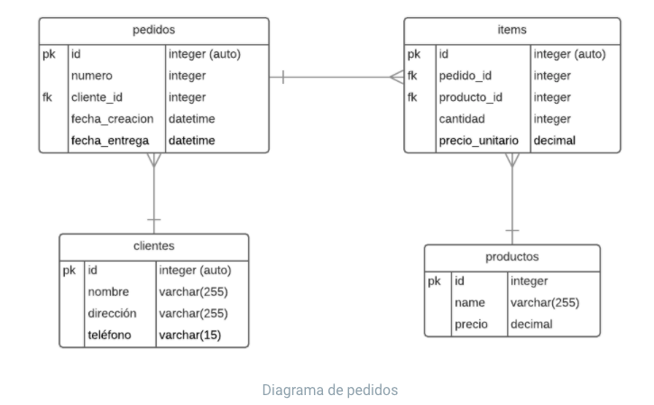
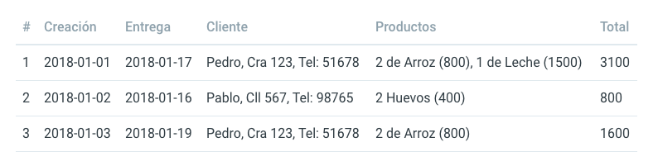
Modelado
Notes:
Cada tabla debe tener una llave primaria (en nuestro caso la llave primaria es el número de pedido así que bien por este lado).
Una tabla debería describir un único objeto o elemento. En nuestro ejemplo, la tabla de pedidos también describe la información de los clientes, los productos y los ítems del pedido.
A este proceso de reducir la redundancia (información repetida) y mejorar la integridad de los datos (evitar errores de digitación) se le conoce como normalización.
Siguiendo las reglas anteriores vamos a separar nuestra gran tabla de pedidos en las siguientes cuatro:
Clientes
Productos
Pedidos
Ítems (del pedido)
El diagrama quedaría de la siguiente forma:
El pedido pertenece a un cliente y un cliente puede tener muchos pedidos. Un pedido tiene muchos ítems y cada ítem pertenece a un pedido. Un ítem tiene un producto y un producto puede aparecer en muchos ítems.
Fíjate que en la tabla de pedidos no tenemos una referencia a los ítems. Por el contrario, cada ítem tiene una referencia al pedido. Al buscar los ítems de un pedido sólo tenemos que buscar los que coincidan con el id de ese pedido.

Slide 13
Tarea | Sentencia
Crear Tablas | CREATE TABLE countries( country_id CHAR( 2 ) PRIMARY KEY, country_name VARCHAR2( 40 ) NOT NULL, region_id NUMBER );
Dropear (Eliminar) Tablas | DROP TABLE table_name;
Insert | INSERT INTO table_name (id, language, author, year) VALUES (2, 'Perl', 'Wall', '1987');

Slide 14
Tarea | Sentencia
Alterar Tablas | ALTER TABLE <Table name> <Operation> <Field with clauses>; Ejemplo Oracle: ALTER TABLE student_details ADD student_grade VARCHAR(5);
Consultar Schema | SELECT column_name,data_type,character_maximum_length FROM INFORMATION_SCHEMA.COLUMNS WHERE table_name = 'proglang_tbluk'; Existen varias opciones dependiendo el DBMS En Oracle se utiliza Describe table_name En SQLite .schema table_name

Slide 15
Consultas simples

Slide 16
Tarea | Sentencia
Select | SELECT language,year FROM table name;
Order | Orden Ascendente SELECT language,year FROM table_name ORDER BY year; -- (Default ASC - orden descendente DESC)
Notes:
The intention since the beginning of SQL was to provide an easy-to-use query system to everyday users. They should not have to reach for a programming language to make their report readable. A major facility for this is the ability to display a finite set of columns in the output rather than all the fields of a table.

Slide 17
Tarea | Sentencia
Order (Cont’d) | SELECT language, year FROM table_name ORDER BY language; Ordenamiento por número campo (Mismo resultado) SELECT language, year FROM table_name ORDER BY 2 DESC; Combinar ordenamientos SELECT language, year FROM table_name ORDER BY year DESC, language ASC;
Notes:
Ordering is not limited to numeric fields. You can order character-based columns too. The sorting method is alphabetical starting with the first character and subsequently moving to the next sequential characters if the character is the same.
A useful shortcut in SQL involves ordering a query result using an integer abbreviation instead of the complete field name. The abbreviations are formed starting with 1, which is given to the first field specified in the query; 2 to the second field; and so on.

Slide 18
Tarea | Sentencia
Where | SELECT language,author FROM table_name WHERE standard = 'ANSI'; Combinando condiciones SELECT language, author, year FROM table_name WHERE year > 1970 AND standard IS NULL; ORDER BY author;
Notes:
We have already seen how to select a subset of data available in a table by limiting the fields queried. We will now limit the number of records retrieved in a query using conditions. The WHERE clause is used to achieve this, and it can be combined with explicit field selection or ordering clauses to provide meaningful output.
For a query to run successfully and fetch data from a table, it must have at least two parts – the SELECT and the FROM clause.1 After this we place the optional WHERE condition and then the ordering clause.

Slide 19

Tarea | Sentencia
Update | UPDATE table_name SET standard = 'ANSI' WHERE language = 'Forth';
Delete | DELETE FROM <table_name> WHERE <condition>;
GroupBy | SELECT year, Book, COUNT(*) -- Utilizamos el comando count para contar. FROM table_name GROUP BY year;
Notes:
We have already seen how to select a subset of data available in a table by limiting the fields queried. We will now limit the number of records retrieved in a query using conditions. The WHERE clause is used to achieve this, and it can be combined with explicit field selection or ordering clauses to provide meaningful output.
For a query to run successfully and fetch data from a table, it must have at least two parts – the SELECT and the FROM clause.1 After this we place the optional WHERE condition and then the ordering clause.

Slide 20
Tarea | Sentencia
Having | SELECT language, standard, year FROM table_name GROUP BY standard, year, language HAVING year < 1980;
Notes:
Like a WHERE clause places conditions on the fields of a query, the HAVING clause places conditions on the groups created by GROUP BY. It must be placed immediately after the GROUP BY but before the ORDER BY clause

Slide 21
Ejercicio

Slide 22
Pasos
Crear Tablas
Insertar datos mediante ‘insert’
Realizar los siguientes reportes básicos
Cantidad de clientes
Lista de Managers y cantidad de empleados que le reportan

Slide 23
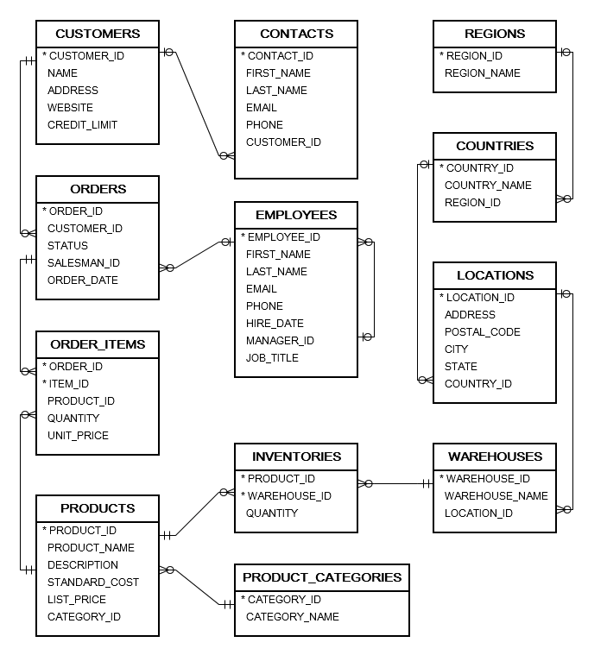
Diagrama Entidad Relación

Slide 24
JOINS

Slide 25
Unión entre tablas
Una operación de unión permite obtener datos de múltiples tablas con una sola sentencia SELECT.
Dos tablas pueden ser unidas mediante un simple JOIN, y su resultado puede ser unido con otras tablas.
Deben existir las mismas, o similares columnas entre las diferentes tablas a unir.
Notes:
A join operation allows you to retrieve data from multiple tables in a single SELECT query. Two tables can be joined by a single join operator, but the result can be joined again with other tables. There must exist a same or similar column between the tables being joined.

Slide 26
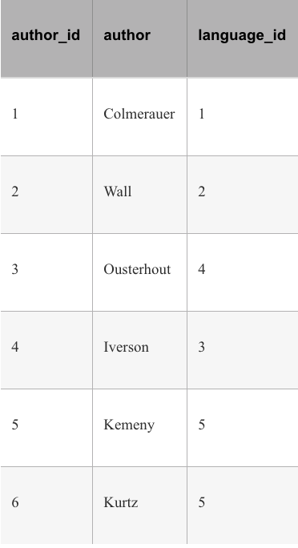
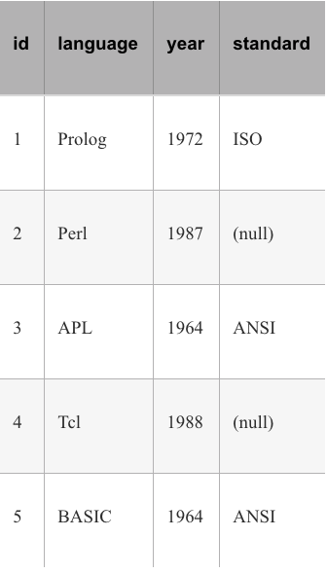
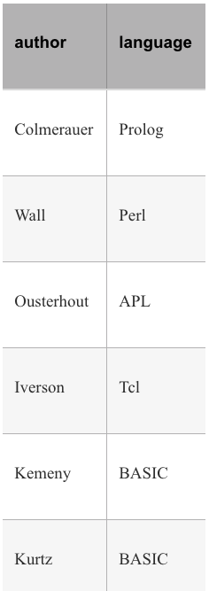
Ejemplo
SELECT author, language
FROM authors_tbl JOIN newlang_tbl
ON language_id = id;
authors_tbl
newlang_tbl
Notes:
The kind of joins where all rows that don’t match the join condition exactly are eliminated are called inner joins . Thus we can optionally use the full keyword INNER JOIN in our queries without affecting the resultset

Slide 27

Resolviendo ambigüedades
SELECT author, language
FROM authors_tbl JOIN newlang_tbl
ON language_id = language_id;
=> ERROR: column reference "language_id" is ambiguous
SELECT author, language
FROM authors_tbl JOIN languages_tbl
ON authors_tbl.language_id = languages_tbl.language_id;
or
SELECT author, language
FROM authors_tbl a JOIN languages_tbl l
ON a.language_id = l.language_id;
Notes:
The kind of joins where all rows that don’t match the join condition exactly are eliminated are called inner joins . Thus we can optionally use the full keyword INNER JOIN in our queries without affecting the resultset

Slide 28
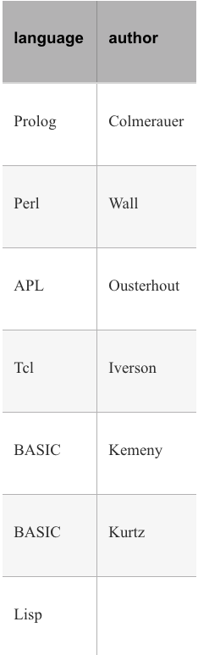
Outer Join
SELECT language, author
FROM newlang_tbl n LEFT OUTER JOIN authors_tbl a
ON n.id = a.language_id;
Notes:
In this kind of join, the resultset consists of rows that match the join condition and the rows that don’t match the condition from one of the tables. If the rows from the first table that don’t match the condition are desired in the resultset, we use a left outer join. Otherwise when rows from the second table are required, we use a right outer join.

Slide 29
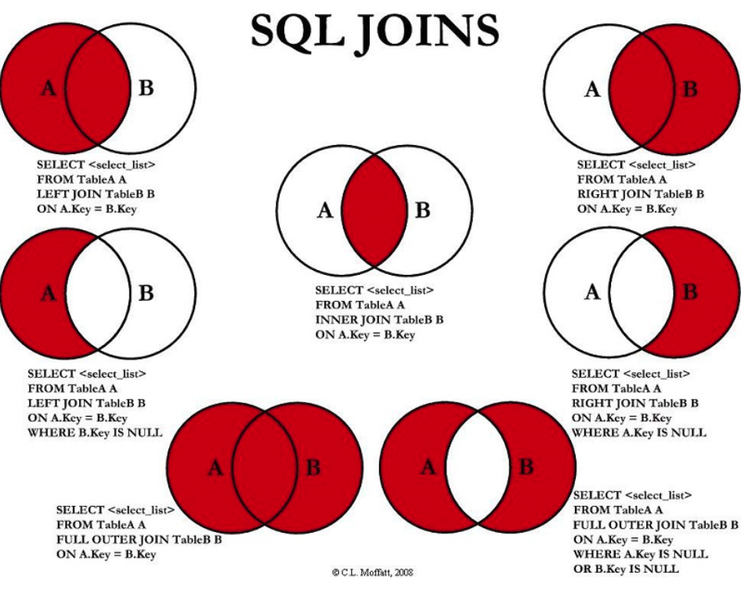

Slide 30
Consultas Correlacionadas (Subquery)

Slide 31
Subquery
Un subquery (o consulta correlacionada) es un query dentro de una consulta superior. Podemos pensarlo como una sentencia SELECT dentro de otra sentencia SELECT.
Tipos de Subquery:
Escalar (Retorna una columna de una fila)
Fila (Retorna una fila con múltiples columnas)
Tabla (Retorna más de una fila)
Notes:
A subquery, simply put, is a query written as a part of a bigger statement. Think of it as a SELECT statement inside another one. The result of the inner SELECT can then be used in the outer query.
1. Scalar subqueries A subquery that returns only a single column of a single row as its output. The example in the previous section, where the subquery returns the id for Tcl, is a scalar subquery.
2. Row subqueries A subquery that returns a single row but more than one column. These are the least important type of subqueries since most database management systems do not support it, including SQLite
3. Table subqueries A table subquery can return more than a single row and many columns per row. In essence, it can return a table itself to take part in your outer query.

Slide 32
Ejemplo
Subquery en WHERE
SELECT author
FROM authors_tbl
WHERE language_id IN
( SELECT id FROM newlang_tbl
WHERE language="Tcl");
Subquery en FROM
SELECT author, language
FROM authors_tbl a,
(SELECT id, language
FROM newlang_tbl
WHERE year > 1980) n
WHERE a.language_id = n.id;
Notes:
The subquery SELECT id FROM newlang_tbl WHERE language='Tcl' picks the correct language id from the newlang_tbl and passes it on to the outer query on the authors table. This frees us from the responsibility of joining the two tables using the language id field.
We can visualize the intermediate step where the subquery has already resolved to a value. The query would now look something like SELECT author FROM authors_tbl WHERE language_id IN

Slide 33
Tarea | Sentencia
Exists | SELECT language, year FROM newlang_tbl WHERE EXISTS (SELECT * FROM authors_tbl WHERE newlang_tbl.id = language_id);
Any | SELECT language FROM newlang_tbl WHERE year > ANY (SELECT year FROM newlang_tbl);
All | SELECT language FROM newlang_tbl WHERE year <= ALL (SELECT year FROM newlang_tbl);
Notes:
The keyword EXISTS tests the presence of any number of rows returned from a subquery. We usually don’t care about the columns being returned by the mere existence of rows satisfying a specific criterion.
The ANY operator used with the arithmetic comparison operators can be used to check a column value in comparison to a similar value(s) generated in the subquery. For example, if we wanted to display all the languages but exclude the oldest one from the result, we could combine > and ANY to achieve this.
The ALL operator works similarly, but the value in the WHERE clause must hold true for all of the values returned from the subquery.
One scenario where ALL gets usage is to find data related to extreme values like minima and maxima. You are of course free to choose the built-in functions MAX and MIN for the purpose too.
SQLITE DOES NOT SUPPORT ANY OR ALL OPERATORS If you tried running the above examples in SQLite, you would get an error message as below.
Error: near "SELECT": syntax error

Slide 34
Ejercicio

Slide 35
Pasos
Realizar los siguientes reportes utilizando sentencias Join
Cantidad de locaciones por región
Cantidad de locaciones por país
Cantidad de Warehouses por locación
Cantidad de productos agrupados por nombre de los mismos
Utilizando una consulta correlacionada obtener el/la/los empleados con mayor cantidad de ventas/operaciones

Slide 36
Diagrama Entidad Relación

